Slide 1
PowerPoint
And
Speech

Slide 2
Content
Subject knowledge
Presentation
Data
Quotes
Images
Video (sparingly)
Audio (sparingly; distracting)

Slide 3
Font Size
12 pt. so this is what it will look like at this size.
20 pt. So this is what it will look like at this size.
24 pt. So this is what it will look like at this size.
28 pt. So this is what it will look like at this size.
32 pt. So this is what it will look like at this size.
36 pt. So this is what it will look like at this size.
Notes:
This needs to be large enough to read from the back of the room

Slide 4
Data

Slide 5
Data 2
25% increase
4 out of 5 people watch Doctor Who

Slide 6
Quotes
Dr. John Smith: “The airspeed of an unladen swallow depends on whether it is an African or Indian Swallow”
World Health Organization: “…signifies that the oncoming zombie apocalypse will decimate 92% of the population”

Slide 7
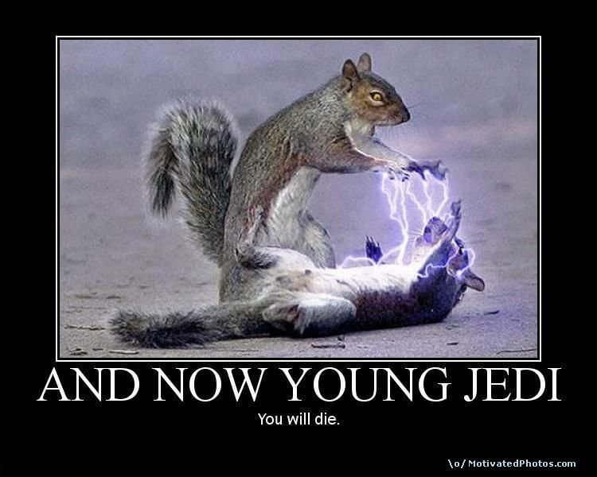
Images and Layout

Slide 8
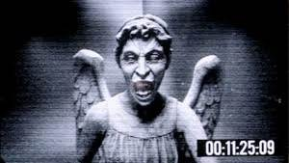
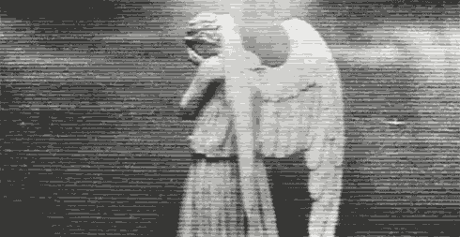
BAD
The Weeping Angels were a species of quantum-locked humanoids, so called because their unique nature necessitated that they often covered their faces with their hands to prevent trapping each other in petrified form for eternity by looking at one another. This gave the Weeping Angels their distinct "weeping" appearance. They were known for being murderous psychopaths, eradicating their victims "mercifully" by dropping them into the past and letting them live out their full lives, just in a different time period. This, in turn, allowed them to live off the remaining time energy of the victim's life. However, when this potential energy paled in comparison to an alternative power source to feed on, the Angels were known to kill by other means, such as snapping their victims' necks.

Slide 9
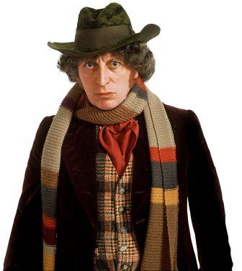
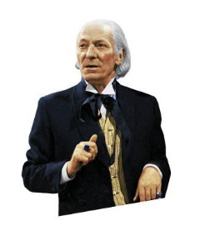
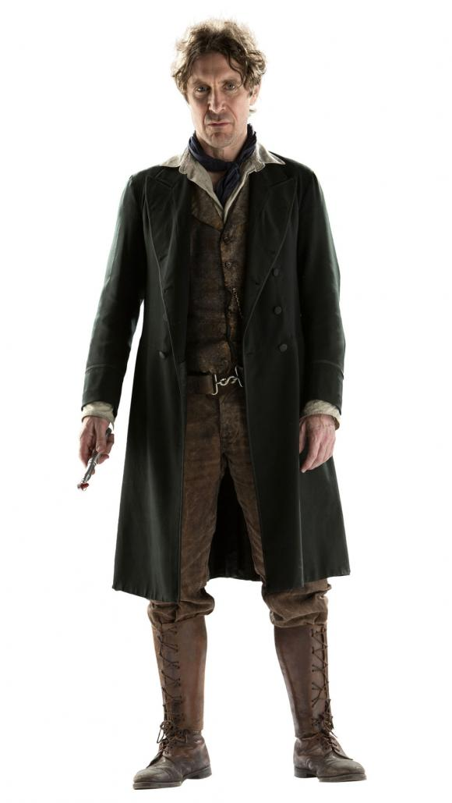
Bad
Fghzdjkghzklghk;bjlbjlzcvkbjzcvlbjzcvlnkjvlzcnkjzvlnkjzcvklnjzvlnkjzcvlnkjvnkljvlnkjvlnkjvnljvlnkjgvJVjChvJBHkCVJBHVJKBhkcvjbhckvjhkcvjhncxvjkhnckxvjnhcvjknhcvkhcvknhkcvjnhcvjk
Fghzdjkghzklghk;bjlbjlzcvkbjzcvlbjzcvlnkjvlzcnkjzvlnkjzcvklnjzvlnkjzcvlnkjvnkljvlnkjvlnkjvnljvlnkj

Slide 10
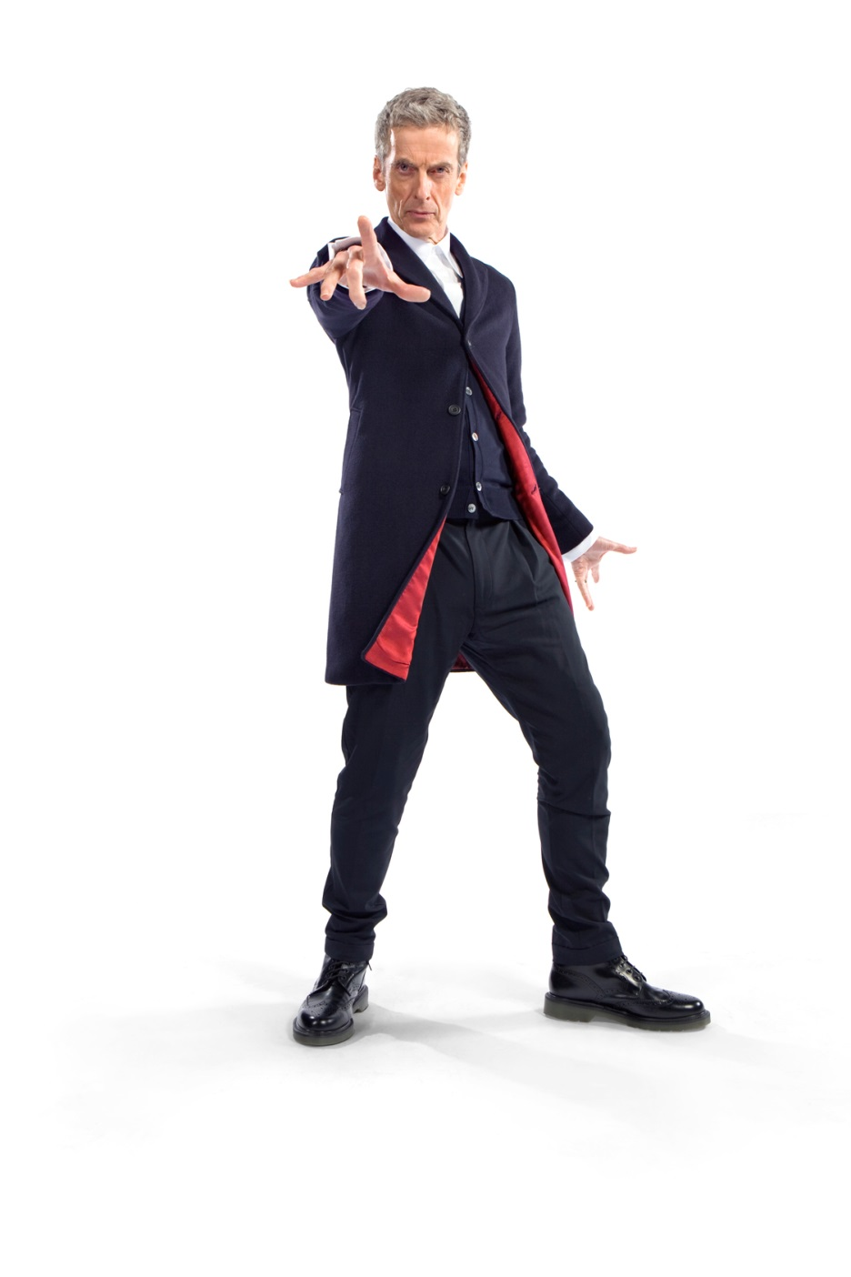
Good
appeared to help his past incarnations save Gallifrey from being destroyed with the Moment.
More Serious
Snappy dresser
Scottish accent
2014
*Do not use more than 2 pictures on a slide

Slide 11
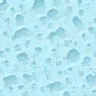
Background with text
Icblkjxcvlbkjcvklbjlkbjzcklbjzcklvbjcvklbjcklbnlzcvkbjlzcvkbjcvklbjcvklbjcvlbkjcvklbjcvlbjlkbjlbkjxcvklbjxlknjklnjlbkj
Jhgzfhkghkhjsfhjhjdjdghljkdglhjklghjkghljkghljkk
usdhfjdfhgjdfhgjksdfghksfjghhjhj

Slide 12
Background 2
This text is not too bad with the background as it is easier to see without difficulty

Slide 13
Animation
Don’t
Go
Crazy

Slide 14
Keep it simple

Slide 15
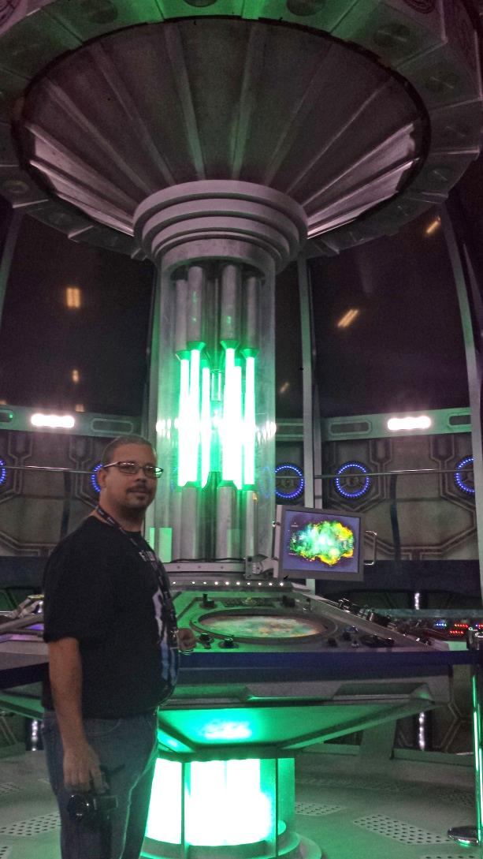
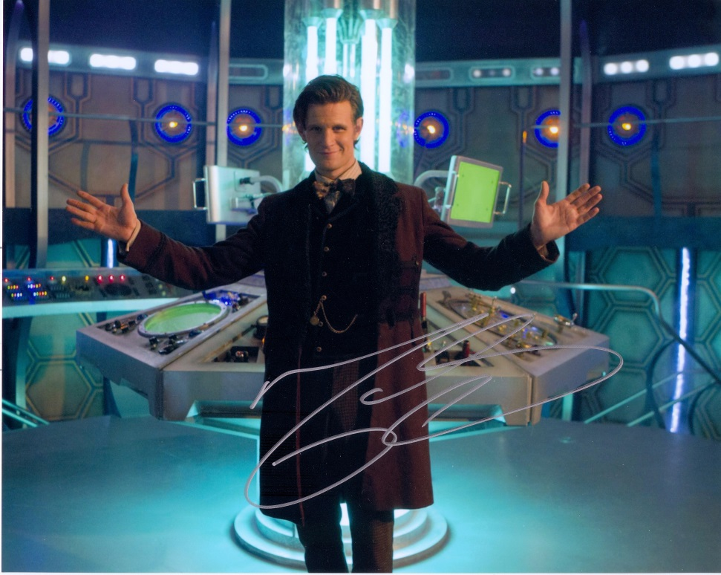
layout

Slide 16
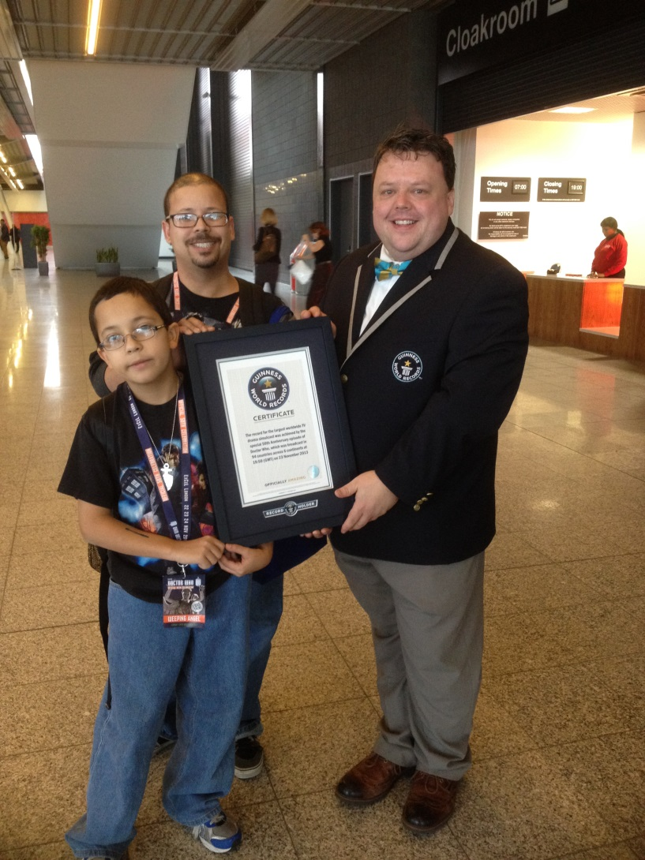
Layout 2
appeared to help his past incarnations save Gallifrey from being destroyed with the Moment.
More Serious
Snappy dresser
Scottish accent
2014

Slide 17
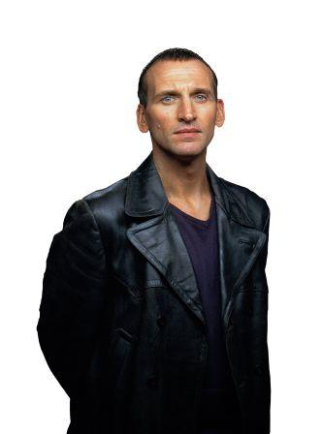

Audio
Who are you?
…fire and ice…

Slide 18
Video
Will be graded for project
Actual Speech – be careful!

Slide 19
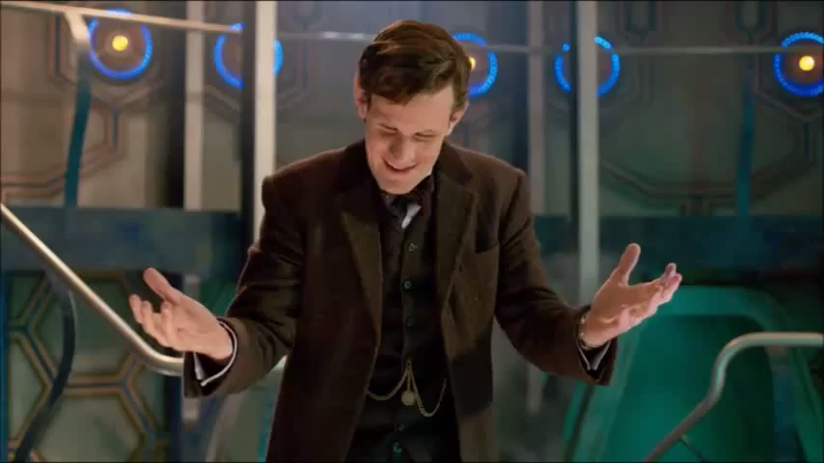
Video

Slide 20
Just like your paper:
Remember the Work Cited!!!

Slide 21
Proof your Power Point!

Slide 22
Speech

Slide 23
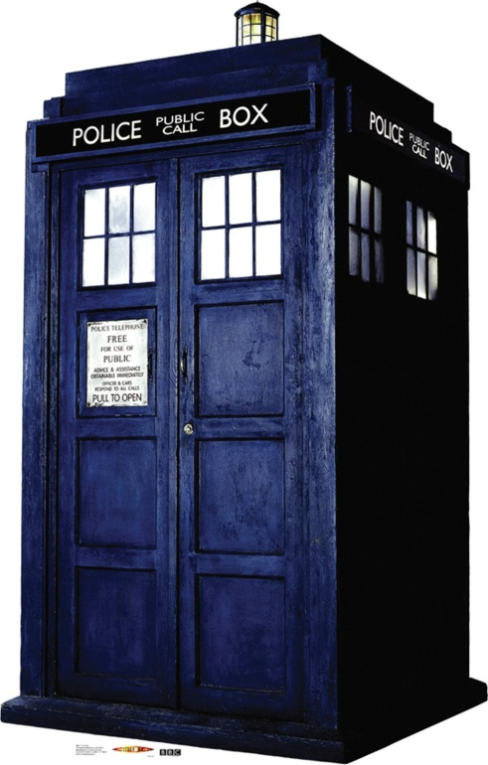
Time
3 - 5 minutes

Slide 24
CONTENT
Attention getter
Announce Topic
Support side of issue
Conclusion

Slide 25
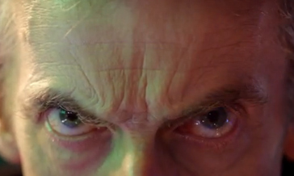
Eye Contact

Slide 26
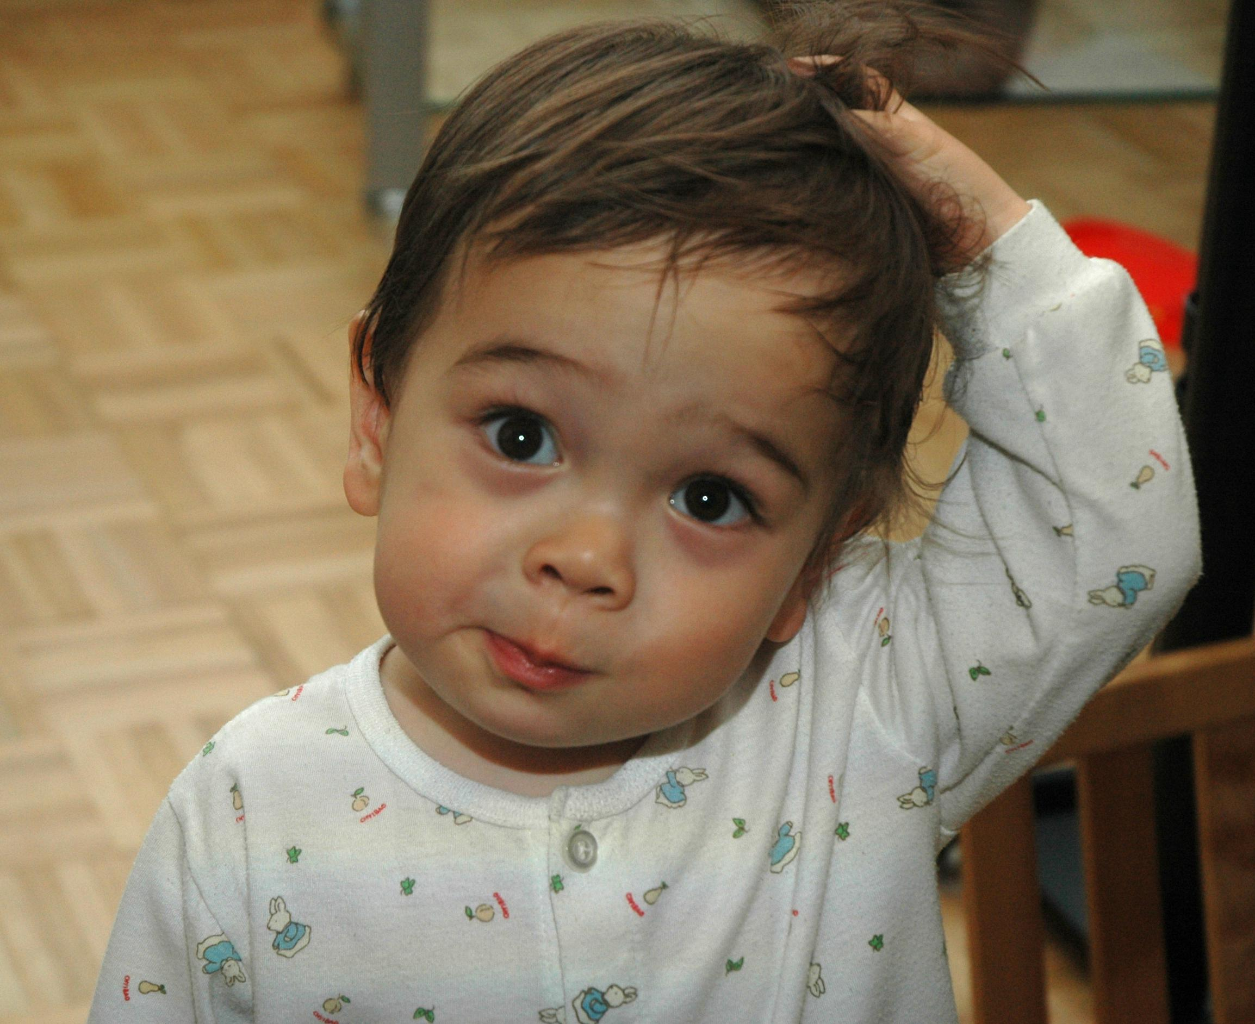
Facial expression

Slide 27
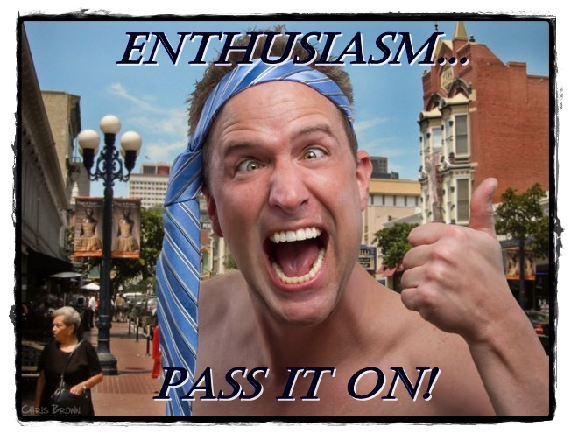

Slide 28
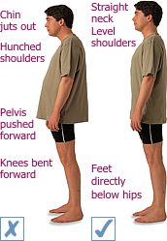
Posture

Slide 29
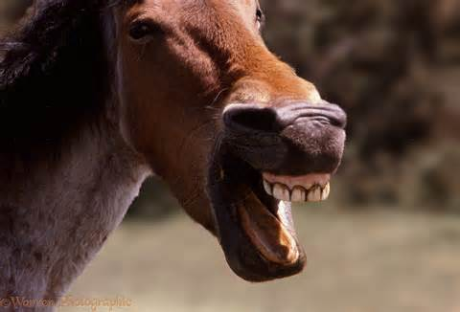
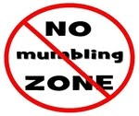
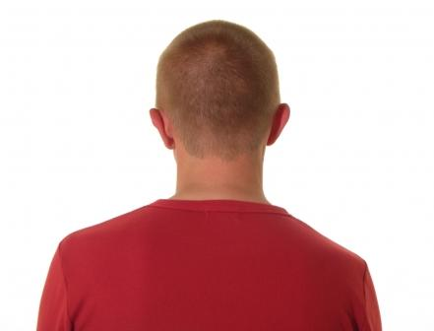
Professionalism

Slide 30
Most Importantly
Practice your speech in advance!

Slide 31
Any Questions
?

