Slide 1
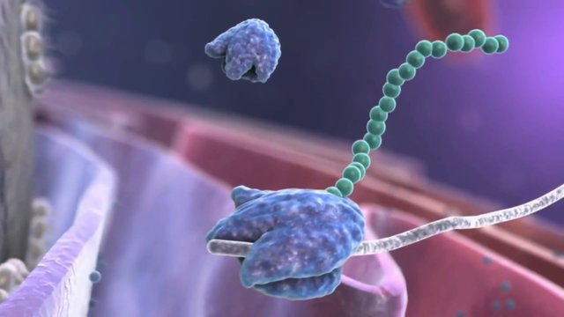
13.1/13.2 Protein Synthesis
From DNA to Protein

Slide 2
Protein Synthesis
  @Protein Synthesis is the process that cells use to produce protein. @
  - it involves 2 distinct phases
  Transcription – occurs in the nucleus
  involves the creation of mRNA
  Translation – occurs in the cytoplasm
  at a ribosome – the protein recipe is “read” and the correct protein is made

Slide 3
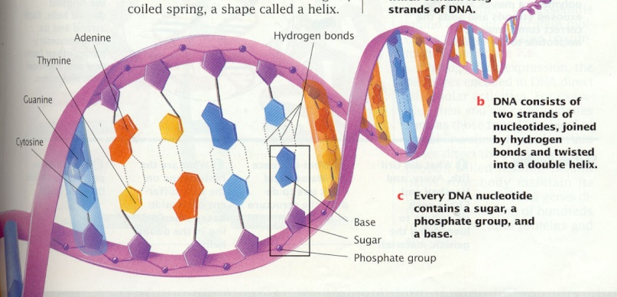
Function of DNA:
controls the function of cells
contains recipes for proteins.
-Proteins are
  Enzymes to run chemical reactions
  Hormones
  Numerous tissues and structures

Slide 4
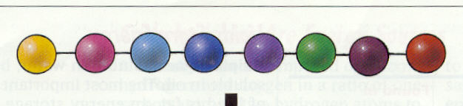
Proteins are chains of amino acids.
amino acid + amino acid + amino acid = protein
(Polypeptides)
The order of amino acids determines protein shape
Shape determines function
DNA recipe consists of the order of amino acids for each protein

Slide 5
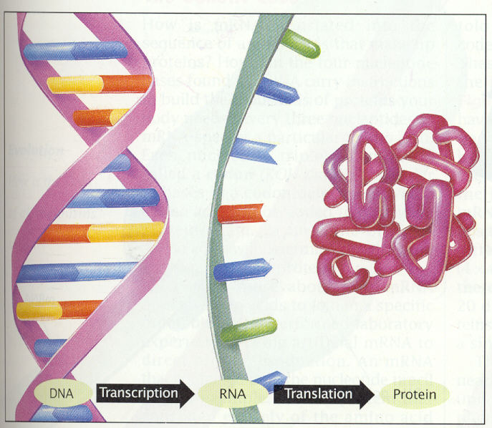
Recipe has to get from DNA to the ribosome which builds the protein

Slide 6
@Transcription: makes a copy of the protein recipe @
This is necessary because:
DNA cannot leave the nucleus!!!
Proteins are made on ribosomes in the cytoplasm.
mRNA provides the solution
      Messenger ribonucleic acid
      mRNA is a copy of the protein recipe that can leave the nucleus

Slide 7
mRNA – messenger RNA
mRNA is a copy of the recipe for a protein. It is a copy of a gene
- it can leave the nucleus
- takes the recipe to the ribosome where it is converted to a protein

Slide 8
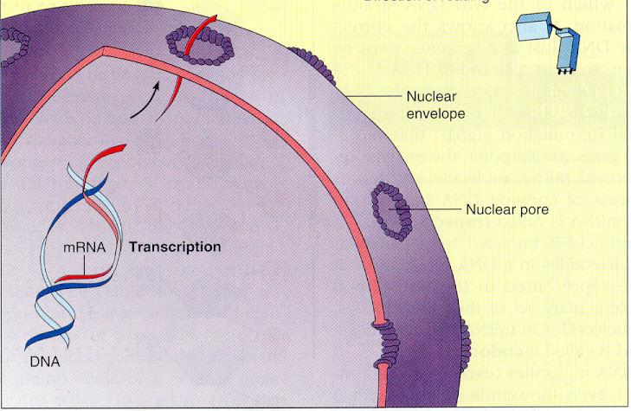
mRNA carries the recipe from DNA to the ribosomes

Slide 9
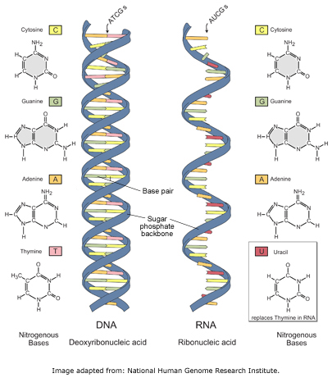
Meet mRNA:
RNA has three structural differences from DNA
Structure of RNA
  @1. Sugar is ribose
  @2. Single strand
  @3. Uracil replaces
  thymine as a
  base pair

Slide 10
Transcription: Initiation
The Process Begins
The enzyme RNA polymerase finds the beginning of a protein recipe called the promotor
- promotor = a series of nucleotides that indicate the start of a protein recipe
The RNA polymerase opens the DNA molecule at the promotor
Notes:
Promotor analogy- title of recipe in cookbook.
If thousands of recipes were in a cookbook together, and they weren’t separated by titles then it would be hard to find them

Slide 11
Transcription: Elongation
Building the mRNA Molecule
RNA polymerase brings RNA nucleotides to the template strand
-pairs them with their complements on the original DNA molecule
-this follows the base pairing rules except that uracil replaces thymine
- Adenine on DNA is paired with Uracil (U) on the new mRNA

Slide 12
Transcription: Termination
The Process Ends
the RNA polymerase continues to add new nucleotides until it reaches the terminator
- the terminator is a sequence of nucleotides that indicates the end of the recipe
the mRNA drops off the DNA
-this is pre-mRNA it needs further
processing before it can be translated

Slide 13
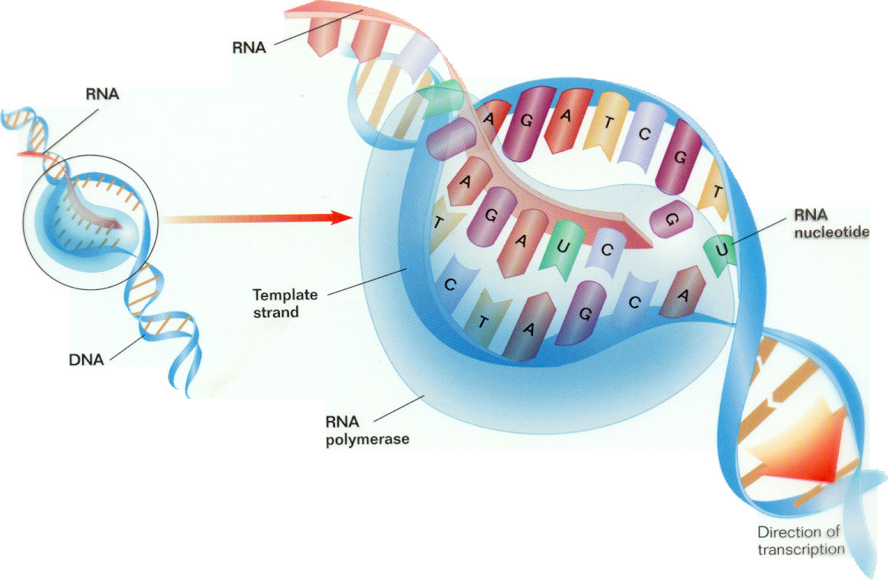

Slide 14
Processing pre-mRNA
Pre-mRNA contains sections of nucleotides called introns
-they are extras and must be removed
before the protein can be built
Pre-mRNA also contains sections called exons
-these contain the protein recipe and are
joined to form the finished or mature
mRNA

Slide 15
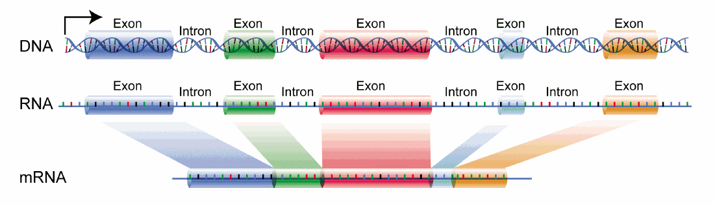
Introns and Exons

Slide 16
Translation
From mRNA to Protein

Slide 17
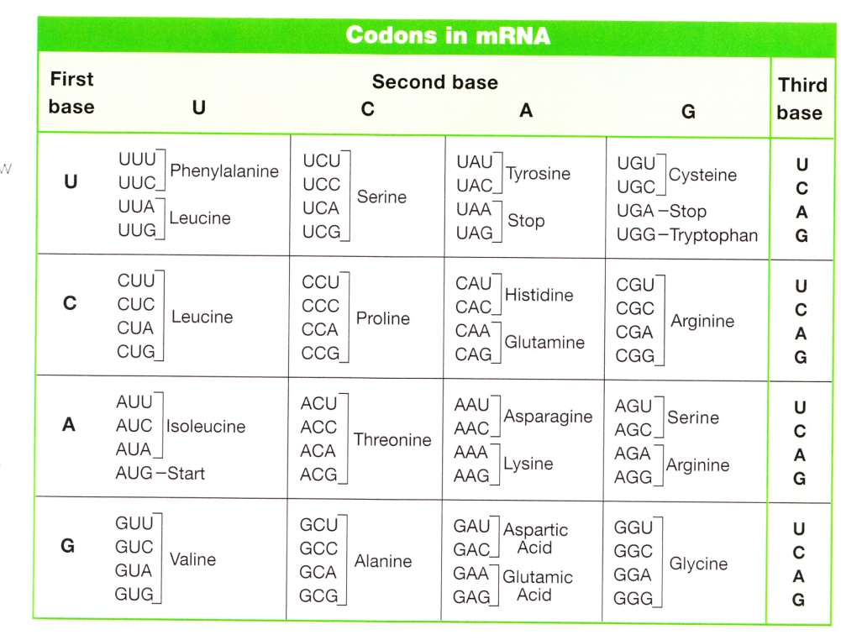
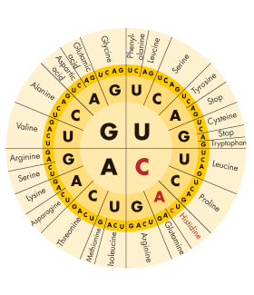
There are twenty different amino acids that build proteins
There are 64 different triplets/codons
Each amino acid is coded for by more than one triplet/codon

Slide 18
The Players
mRNA:messenger RNA
- carries protein recipe from the nucleus
tRNA: transfer RNA
-brings amino acids to the ribosome
Ribosome: the site of protein synthesis
- made of rRNA (ribosomal RNA )and Protein

Slide 19
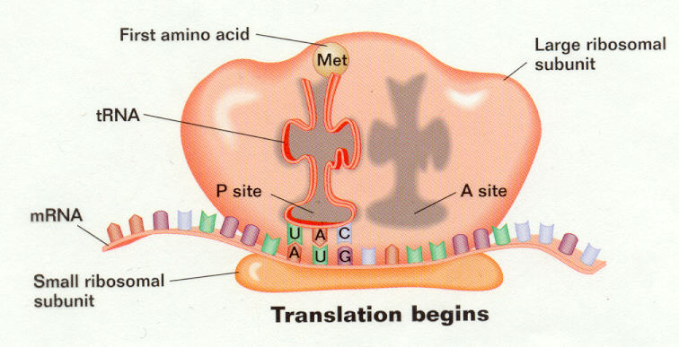
The Process of Translation
@mRNA takes recipe to the ribosome in cytoplasm to make a protein@
ribosome attaches to the mRNA

Slide 20
Translation
The ribosome moves along the mRNA until it reaches the “Start” codon
Start codon = AUG signals the start of the recipe
AUG also codes for the amino acid methionine

Slide 21
The process of Translation cont.
A molecule of transfer RNA brings the amino acid called for by the mRNA to the ribosome
transfer RNA = tRNA

Slide 22
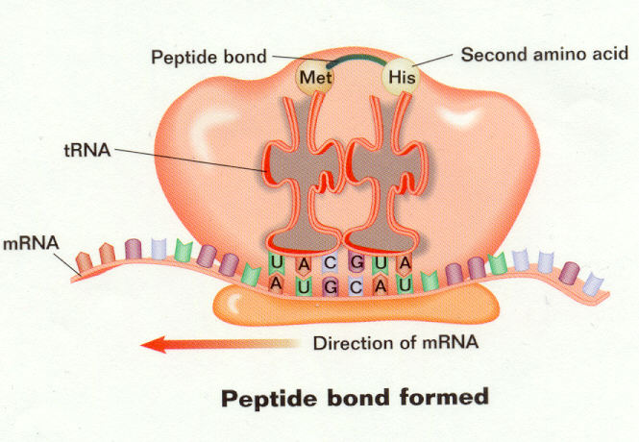
The process of Translation cont.
A second tRNA brings the second amino acid to the ribosome
The amino acids are joined together to begin the protein
The process continues until the stop codon on the mRNA is reached

Slide 23
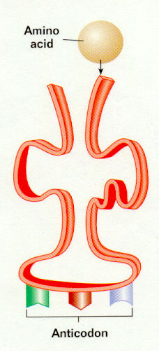
How does tRNA know which amino acid goes where?
@The anticodon on tRNA is complementary to a mRNA codon@
the amino acid that a tRNA molecule
carries is the amino acid that the complementary mRNA codon codes for
Example:
mRNA codon = GAC = aspartic acid
tRNA anticodon = CUG carries only aspartic acid

Slide 24
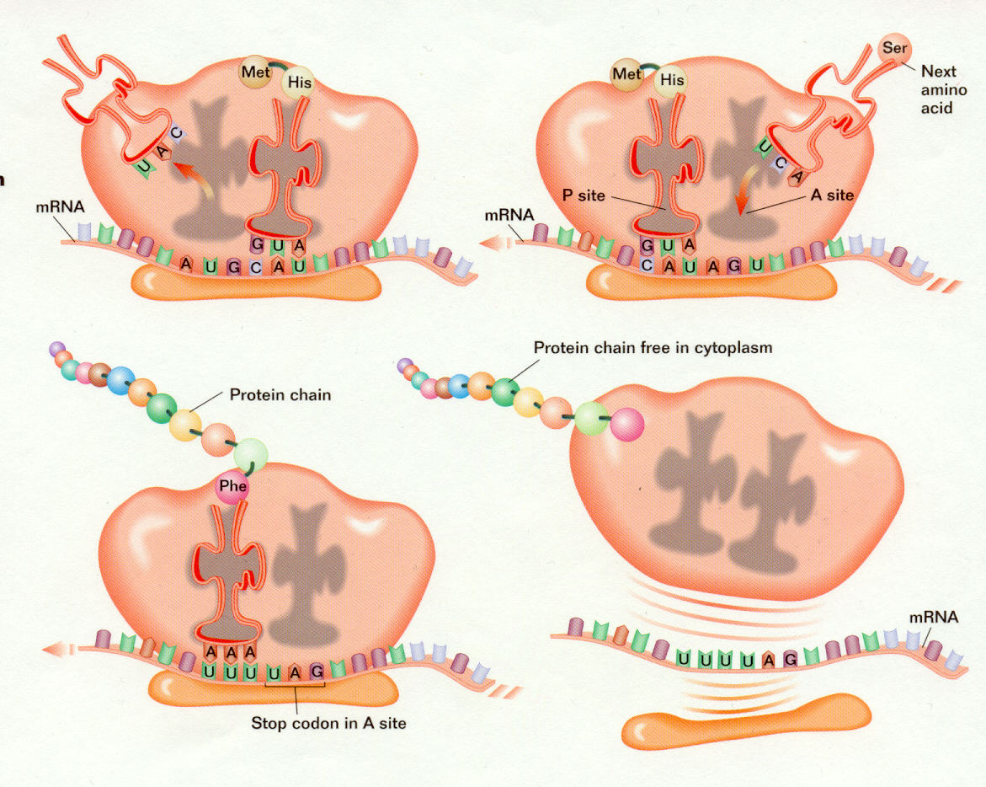

Slide 25
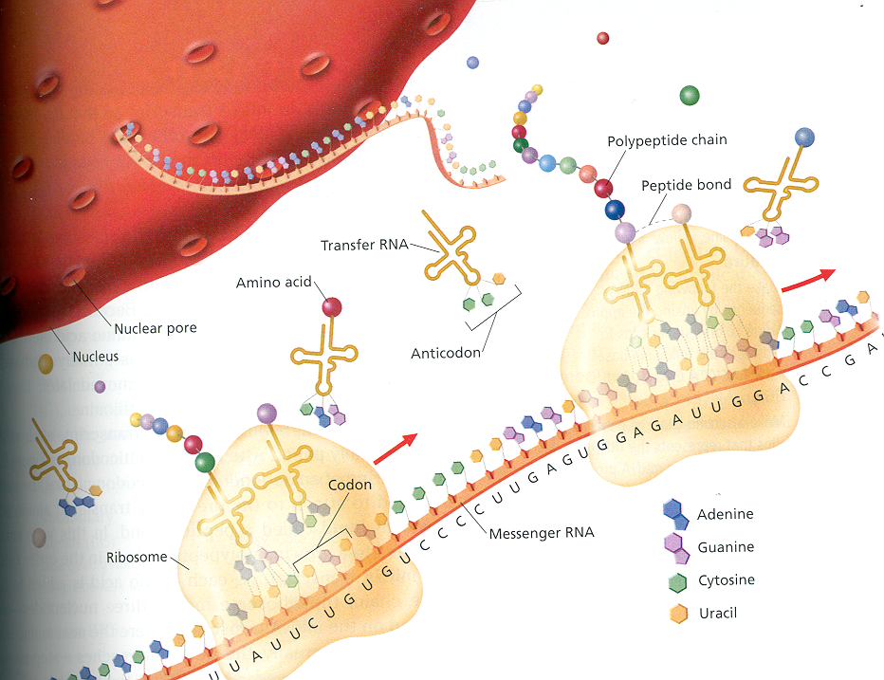
Making the building(protein)

Slide 26
What is the function of mRNA?
It is a copy of the DNA and is used as the template for making proteins.

Slide 27
What happens in the process of transcription?
Translation?
Transcription copies the DNA into mRNA inside the nucleus
Translation reads the copied mRNA to form proteins. Occurs
On the ribosomes located in the cytoplasm

Slide 28
There is an mRNA sequence of AAG, what is the
Corresponding amino acid?
Lysine

