Slide 1
BY: JEREMY GONZALEZ
TEACHER: MS TUEL
DATE: FEBRUARY 19, 2015

Slide 2
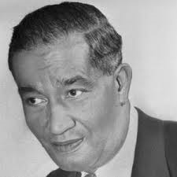
FREDERICK MCKINLEY JONES

Slide 3
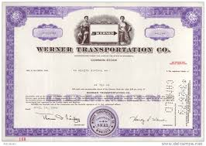
WHERE HE WORKED
WERNER TRANSPORTATION

Slide 4
HIS INVENTION: THE ICE CREAM TRUCK

Slide 5
No kids

Slide 6
Didn’t get married

Slide 7
LEARNED ABOUT CARS

Slide 8
Hobbies were learning about cars

Slide 9
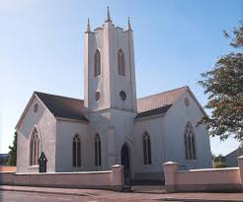
His child hood was mostly spent cleaning the Catholic church he lived in.

Slide 10
BORN ON FEBUARY16,1893

Slide 11
DIED ON MAY16,1961

Slide 12
BECAME AN INVENTOR AT AGE 21

Slide 13
WHERE HE LIVED: CATHOLIC CHURCH

Slide 14
HE RAN AWAY AT AGE 7

Slide 15
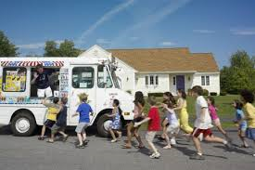
His accomplishment was to make a vehicle that carries ice cream to children.

Slide 16
I found all my information on
http/africanamericaninventors.org
http://www.histarch.illinois.edu
http://freemaninstitute.com

Slide 17
What I learned from this inventor is that he is a smart man who helped a lot of people for no cost.

Slide 18
THE END

