Slide 1
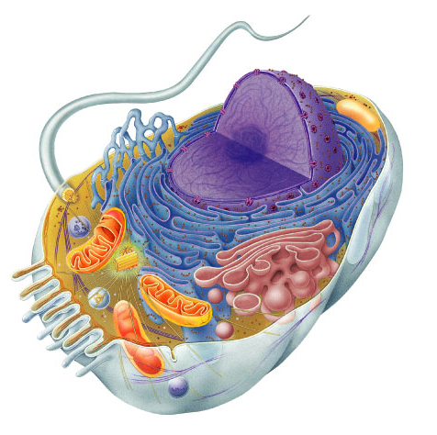
7.3 Cell Transport

Slide 2
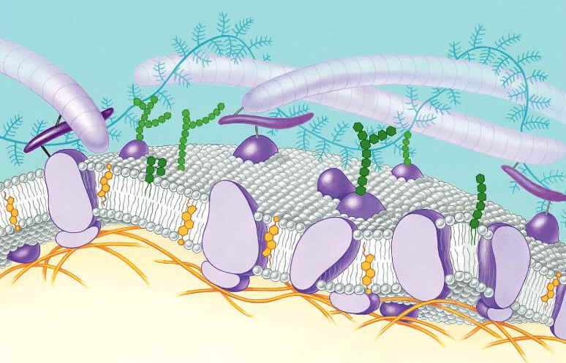
Function of the Cell Membrane:
Cell membrane separates the components of a cell from its environment—surrounds the cell
Regulates the flow of materials into and out of cell—selectively permeable
Cell membrane helps cells maintain homeostasis—stable internal balance

Slide 3
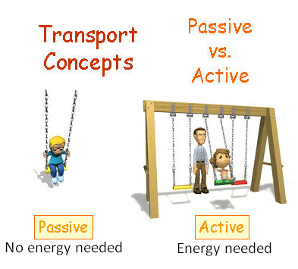
Passive Transport
A process that does not require energy to move molecules from a HIGH to LOW concentration
Diffusion
Osmosis
Facilitated Diffusion

Slide 4
Diffusion is the movement of small particles across a selectively permeable membrane until equilibrium is reached.
These particles move from an area of high concentration to an area of low concentration.
outside of cell
inside of cell

Slide 5
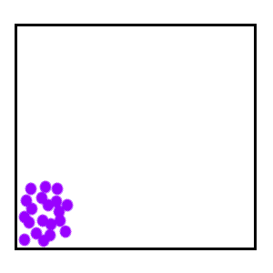
Diffusion
HIGH to LOW concentration

Slide 6
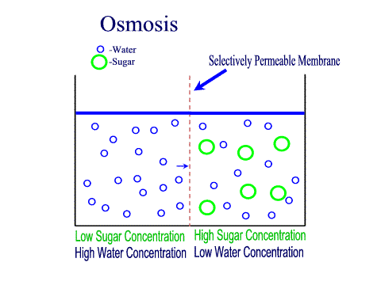
Osmosis is the diffusion of water through a selectively permeable membrane.
Water diffuses across a membrane from an area of high concentration to an area of low concentration.
Semi-permeable membrane is permeable to water, but not to sugar

Slide 7
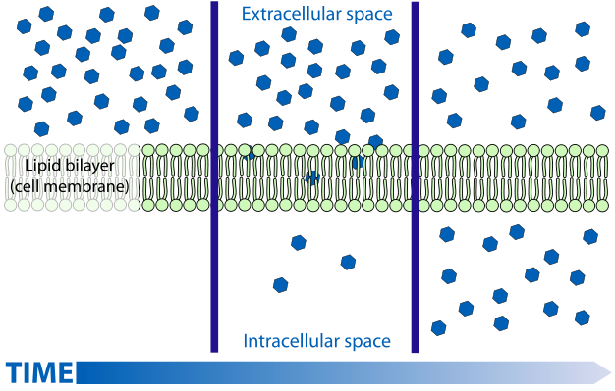

Slide 8
Facilitated Diffusion is the movement of larger molecules like glucose through the cell membrane – larger molecules must be “helped”
Proteins in the cell membrane form channels for large molecules to pass through
Glucose molecules
outside of cell
inside of cell

Slide 9
Hypertonic Solutions: contain a high concentration of solute relative to another solution (e.g. the cell's cytoplasm). When a cell is placed in a hypertonic solution, the water diffuses out of the cell, causing the cell to shrivel.
Hypotonic Solutions: contain a low concentration of solute relative to another solution (e.g. the cell's cytoplasm). When a cell is placed in a hypotonic solution, the water diffuses into the cell, causing the cell to swell and possibly explode.
Isotonic Solutions: contain the same concentration of solute as another solution (e.g. the cell's cytoplasm). When a cell is placed in an isotonic solution, the water diffuses into and out of the cell at the same rate. The fluid that surrounds the body cells is isotonic.

Slide 10
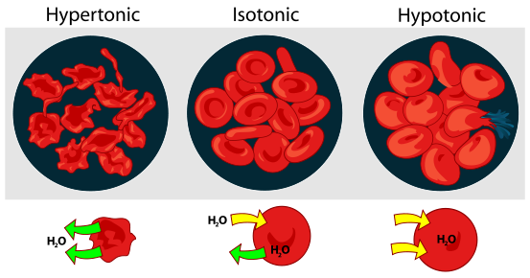
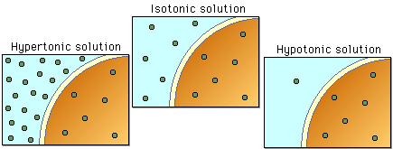

Slide 11
Active Transport
Active transport is the movement of molecules from LOW to HIGH concentration.
Energy is required as molecules must be pumped against the concentration gradient.
Proteins that work as pumps are called protein pumps.
Ex: Body cells must pump carbon dioxide out into the surrounding blood vessels to be carried to the lungs for exhale. Blood vessels are high in carbon dioxide compared to the cells, so energy is required to move the carbon dioxide across the cell membrane from LOW to HIGH concentration.
outside of cell
Carbon Dioxide molecules
inside of cell

Slide 12
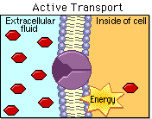
High
Low

Slide 13
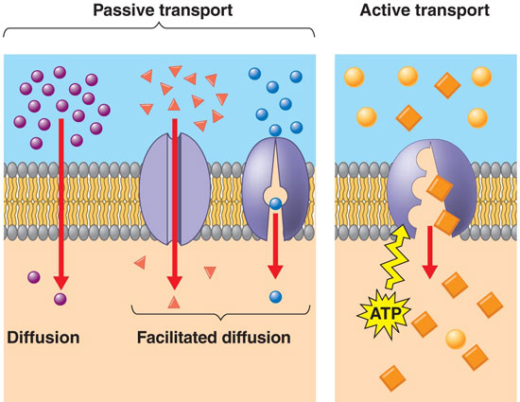

Slide 14
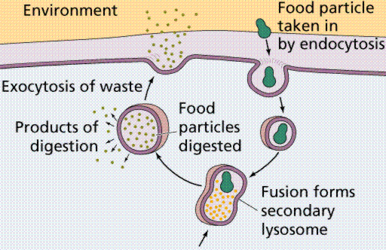
Endocytosis and Exocytosis is the mechanism by which very large molecules (such as food and wastes) get into and out of the cell
Food is moved into the cell by Endocytosis
Wastes are moved out of the cell by Exocytosis

Slide 15
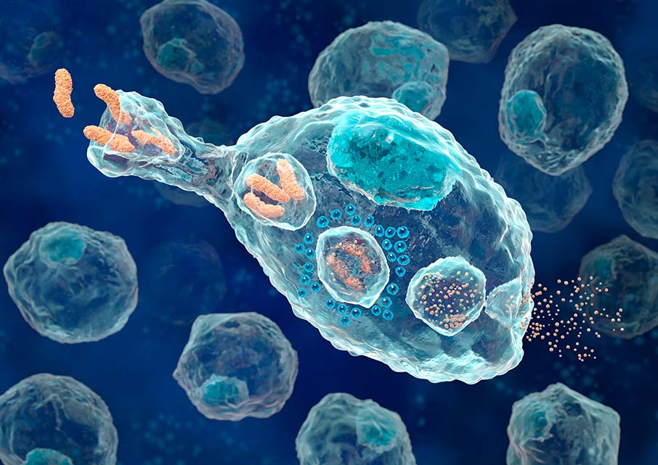
Ex: White Blood Cells, which are part of the immune system, surround and engulf bacteria by endocytosis

Slide 16
What is the difference between passive and active transport?
Passive requires no energy and moves from high to low
Active requires energy and moves from low to high.

Slide 17
In a hypotonic solution…
Cell shrivels up
Cell swells up
Remains the same

Slide 18
In a hypertonic solution…
Cell shrivels up
Cell swells up
Remains the same

Slide 19
Food is moved out of the cell by the process of
Phagocytosis
Exocytosis
Endocytosis

